Slide 1


AtliQ Grands’ Hotels Revenue Analysis
Increase(Regain) Revenue & Market Share Using Data Driven Analysis | Hospitality Domain
Codebasics Resume Project Challenge | Revenue Analysis
Presented By : BISWAJIT SASMAL
Date : 10th March , 2026

Slide 2

Table of Content
Company Overview
Project Problem Statement
Project Task
Dataset & Methodology
Some Crucial Insights
Recommendation

Slide 3


Company Overview
AtliQ Grands owns multiple five-star hotels across India In Major Cities (Delhi , Mumbai , Bangalore, Hyderabad). They have been in the hospitality industry for the past 20 years.

Slide 4
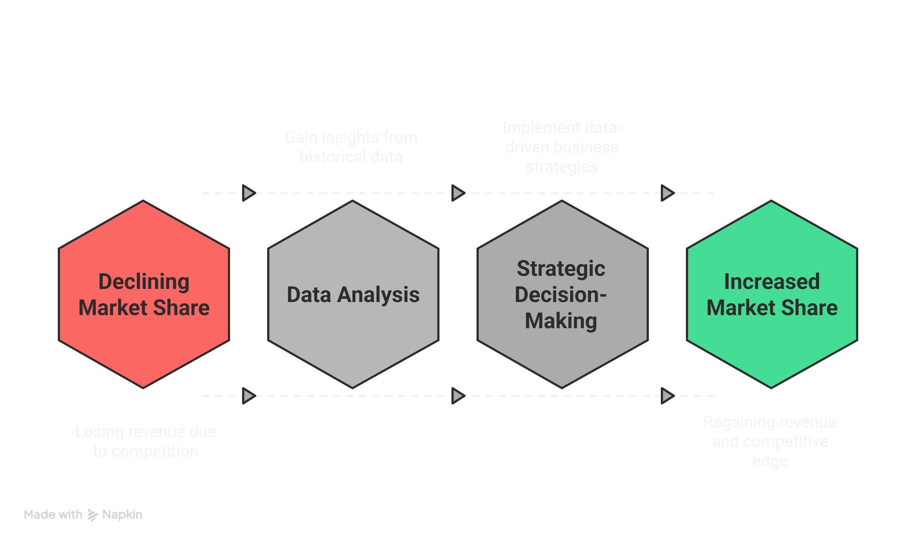
Project Problem Statement
Due to strategic moves from other competitors and ineffective decision-making in management, AtliQ Grands are losing its market share and revenue in the luxury/business hotels category. As a strategic move, the managing director of AtliQ Grands wanted to incorporate “Business and Data Intelligence” to regain their market share and revenue. However, they do not have an in-house data analytics team to provide them with these insights. Their revenue management team had decided to hire a 3rd party service provider to provide them with insights from their historical data.

Slide 5
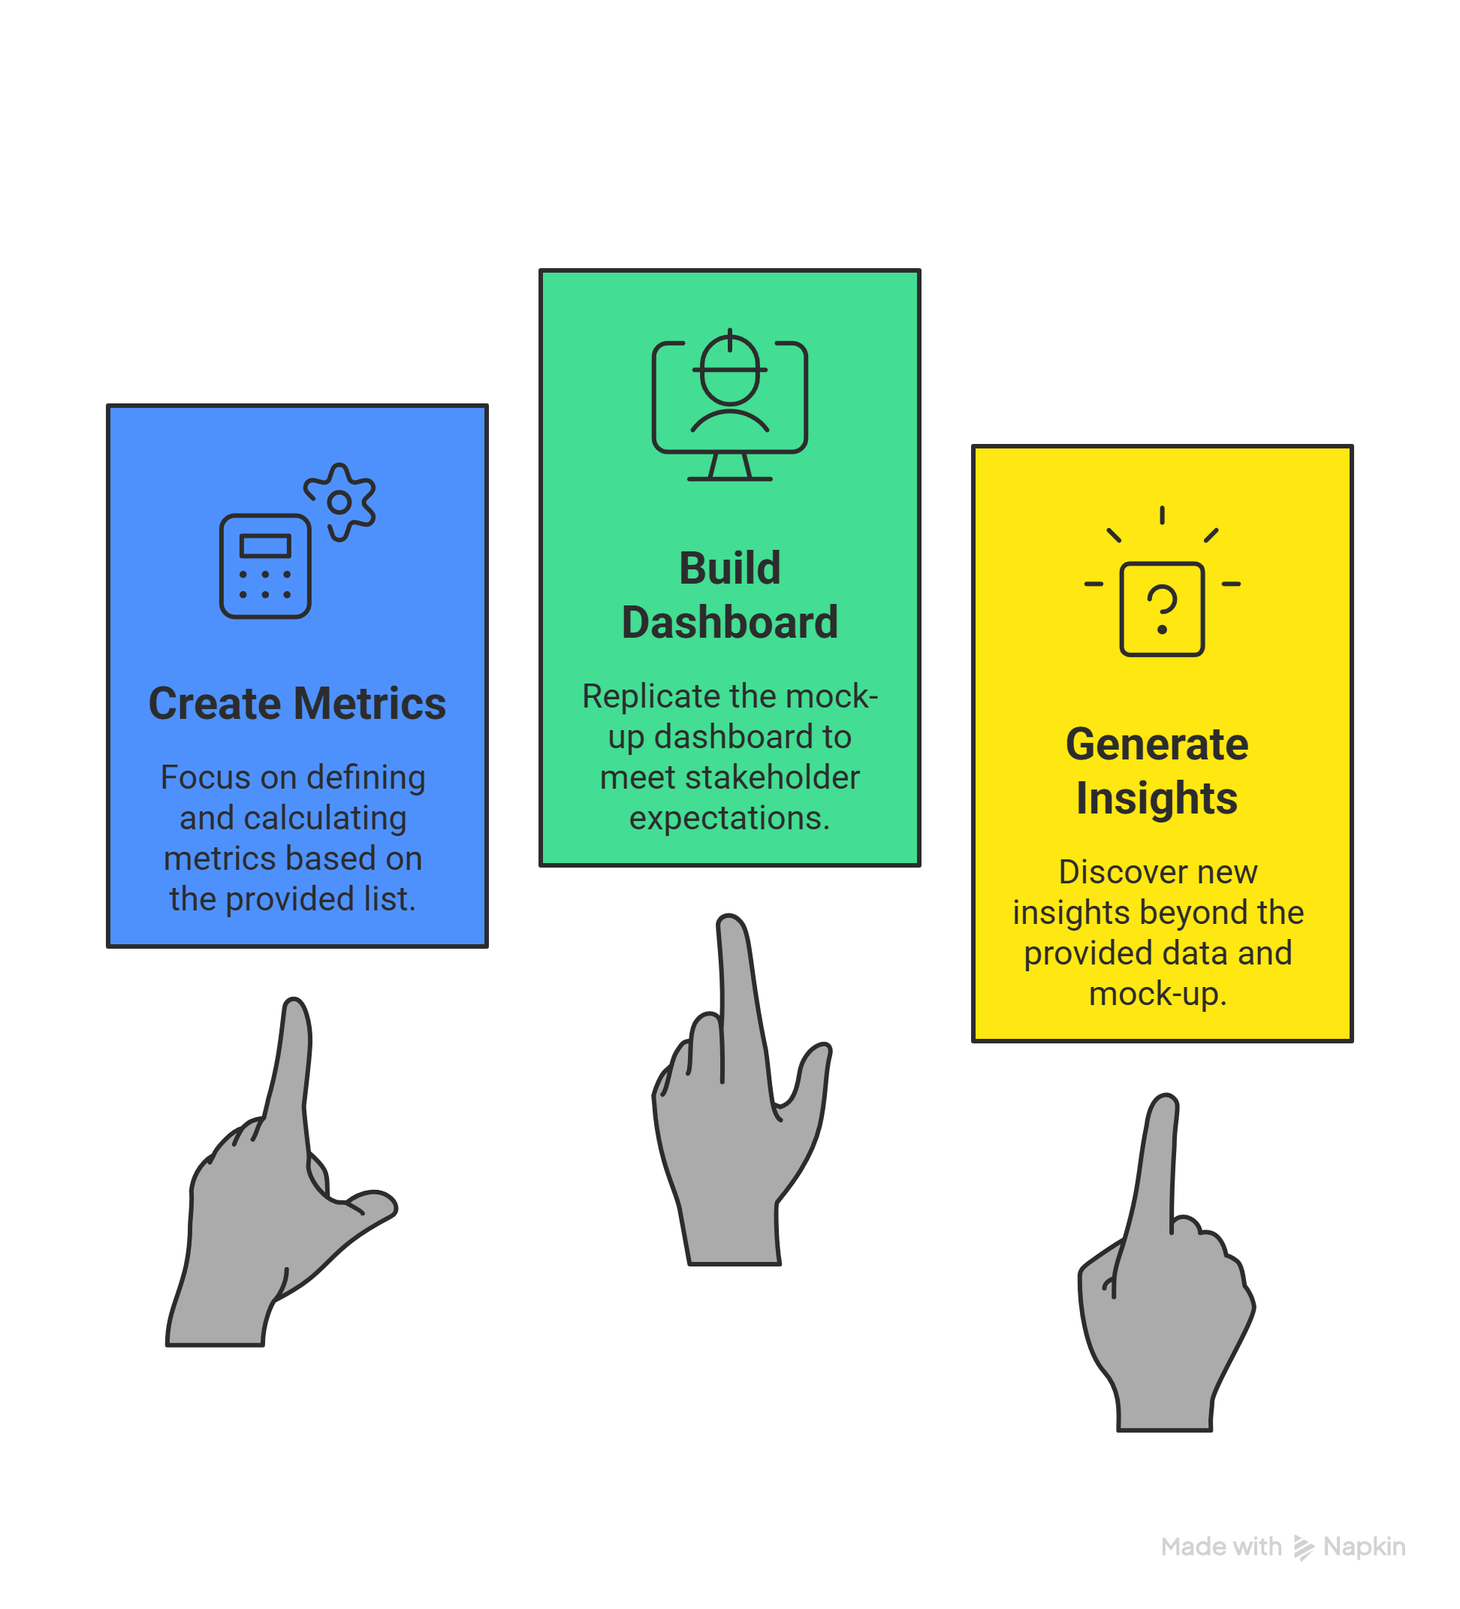
Project Task
You are a data analyst who has been provided with sample data and a mock-up dashboard to work on the following task.
1. Create the metrics according to the metric list.
2. Create a dashboard according to the mock-up provided by stakeholders.
3. Create relevant insights that are not provided in the metric list/mock-up dashboard.

Slide 6


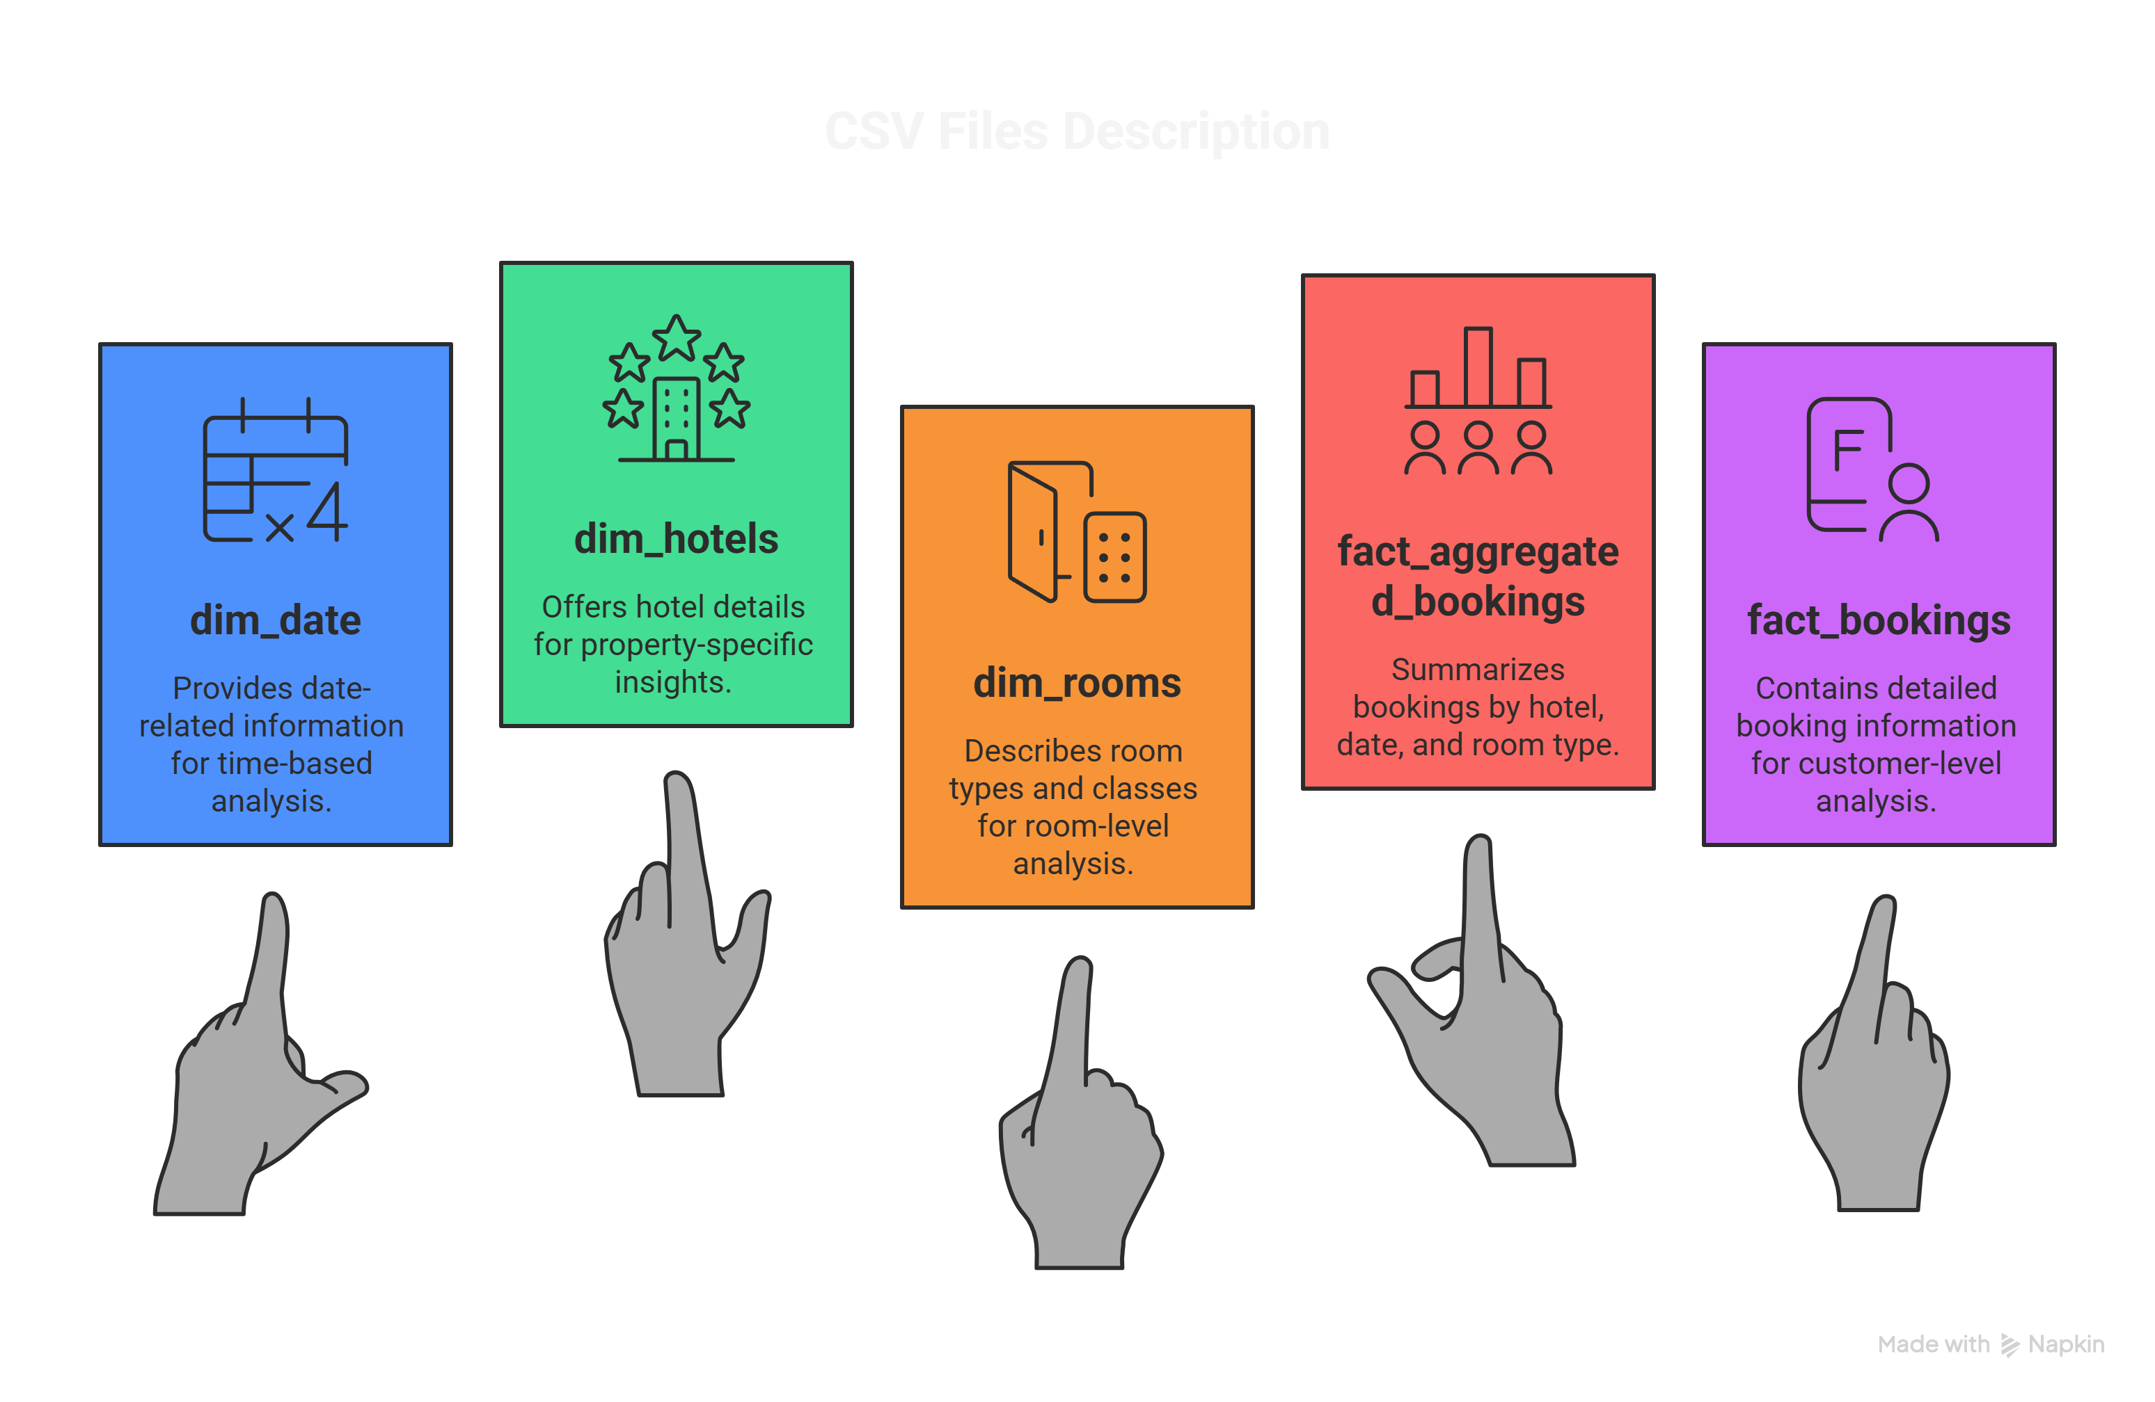
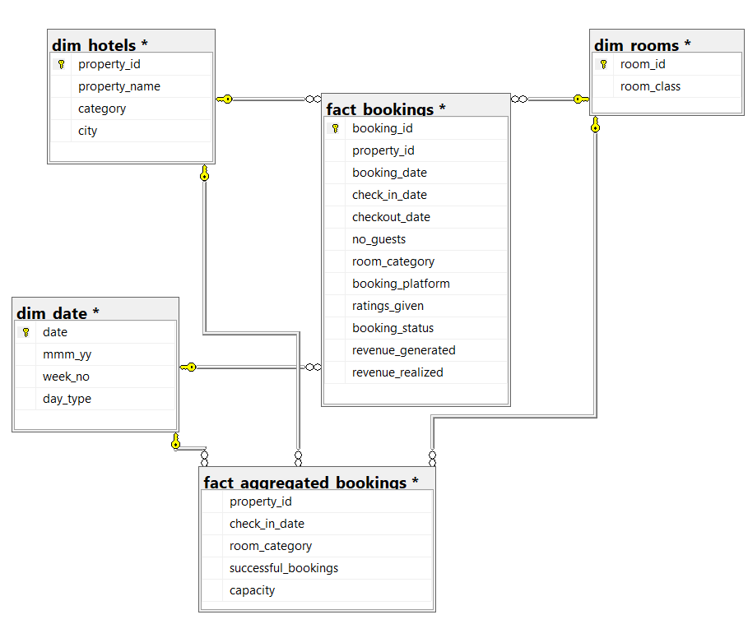
Dataset & Methodology
For This Project I’m Using SQL Server Management Studio (SSMS) to solve business Questions and data understanding & Power BI Desktop for Data Visualization
Database ER Diagram

Slide 7
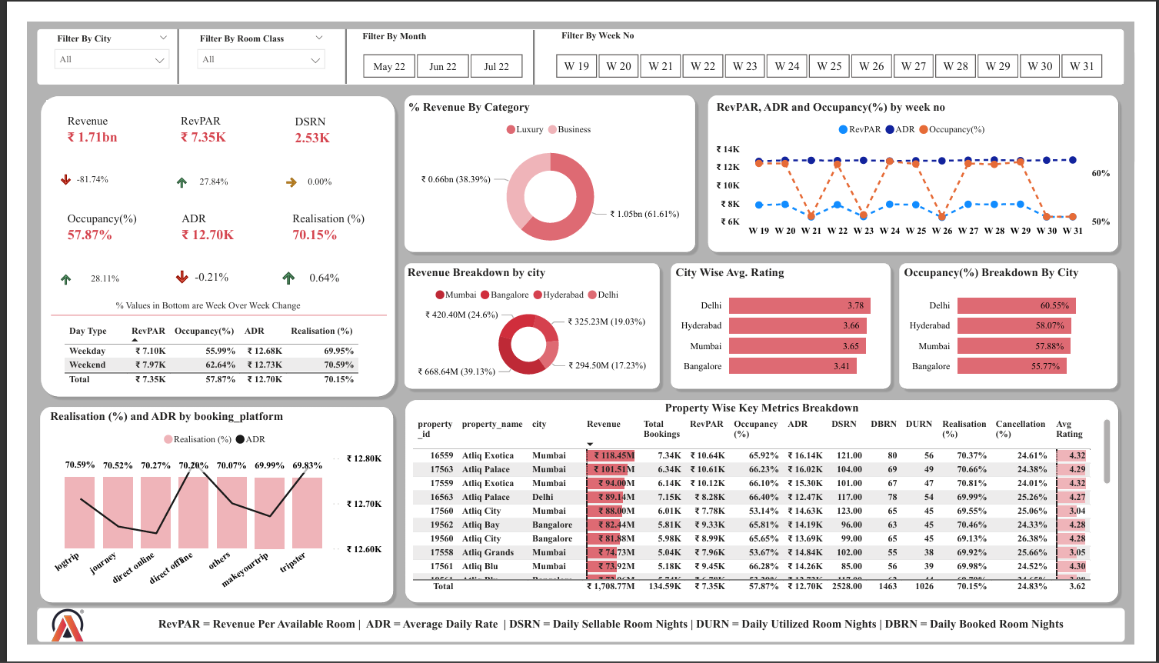
Power BI Report at a Glance
Power BI Live Dashboard Link

Slide 8
Some Crucial Insights
Total Revenue: AtliQ Grands recorded a total revenue of ₹1.71B over the three-month period (May–July 2022).
Revenue by Hotel Category: Luxury hotels dominated revenue contribution at 62% (₹1.05B), while Business hotels accounted for the remaining 38% (₹656.01M).
Revenue by City: Mumbai led city-wise revenue at 39% (₹668.64M), followed by Bangalore at 25% (₹420.40M), with Delhi & Hyderabad jointly contributing 36% (₹619.73M).
Occupancy by Day Type: Weekend occupancy (62.64%) consistently outperformed weekday occupancy (55.99%) across the period.
Overall Performance: Overall Realisation stood at 70.15% against an Occupancy rate of 57.87%.
Realisation by Platform: Realisation (%) remained largely uniform across all booking platforms and channels.
RevPAR: Overall Revenue Per Available Room (RevPAR) was ₹7.35K.
ADR: Overall Average Daily Rate (ADR) was recorded at ₹12.70K.
Revenue Leakage: Out of ₹2.01B gross revenue generated, ₹298.77M (15%) was lost due to booking cancellations, yielding a net revenue of ₹1.71B.
Cancellation Rate: The overall booking cancellation rate was 24.83%, representing a significant area of revenue recovery opportunity.

Slide 9
Recommendation
Fix the Cancellation Problem — It's Costing ₹298.77M AtliQ Grands is losing 15% of every rupee it earns just because customers cancel their bookings. The fix is simple — charge a small cancellation fee or offer a discount to customers who don't cancel. This way, customers think twice before cancelling, and AtliQ keeps more of the money it already earned.
Push More Weekend Bookings — People Are Already Coming Weekends already have higher occupancy (62.64%) compared to weekdays (55.99%). This means people want to stay on weekends. AtliQ should run special weekend deals and packages to fill even more rooms and earn more during those days instead of leaving empty rooms on the table.
Focus More on Mumbai & Luxury Hotels — That's Where the Real Money Is Mumbai alone brings in 39% of all revenue, and Luxury hotels bring in 62% of all revenue. These two are clearly the strongest performers. AtliQ should invest more in improving the experience at Mumbai properties and Luxury hotels — better service, better marketing — because every extra rupee spent there will return far more than spending it somewhere weaker.
Target Corporates in Delhi & Hyderabad — Partner with local companies for bulk weekday bookings and upgrade basic business amenities to grow the weakest 36% revenue contribution.

Slide 10




Thank You
BISWAJIT SASMAL
Aspiring Data Analyst
Connect With Me

